Slide 1

Multilingual RAG System
Kinjal Bandopadhyay

Slide 2

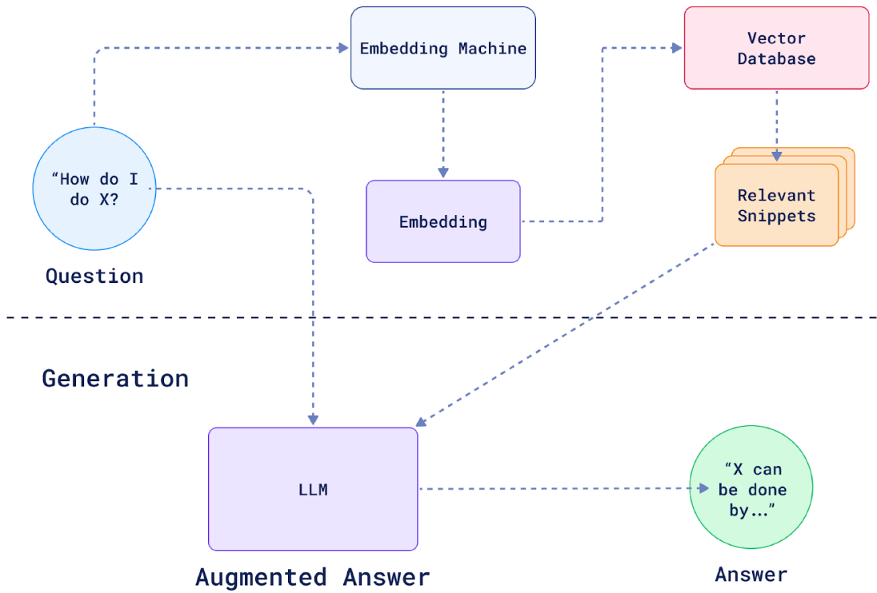
Project Overview
The Multilingual Retrieval-Augmented Generation (RAG) System is designed to handle the complexities of processing documents in multiple languages—Hindi, Bengali, Chinese, and English. The system combines advanced Natural Language Processing (NLP) techniques with efficient data storage solutions to provide accurate document retrieval and generation capabilities.
Source:www.quadrant.tech

Slide 3
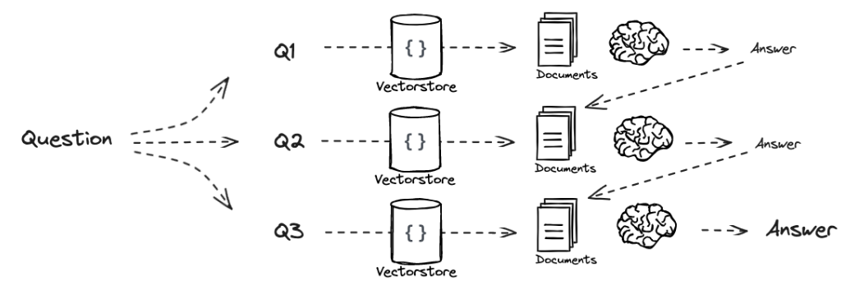
Objectives:
To develop a system that can extract text from both scanned and digital PDFs.
To implement advanced mechanism to retrieve relevant information efficiently.
To ensure the system can handle up to 1TB of data while maintaining high performance.
To Ensure the system can handle various languages, providing seamless multilingual support for document processing.
Fig: Query Decomposition (source: www.github.com/Langchain-ai)

Slide 4

Challenges Faced
Choosing the right algorithm for creating sparse vectors was crucial. Traditional methods like TF-IDF were found to be ineffective for multilingual inputs, as they do not account for the nuances and variations across different languages.
Determining which vector database to use for storing embeddings was critical, especially given the requirement to scale up to 1TB of data. The chosen solution needed to offer efficient querying and storage capabilities without compromising on speed.

Slide 5
Challenges Faced
Selecting an appropriate model for multilingual inference posed another significant challenge. The goal was to find a model with fewer parameters while maintaining accuracy and sufficient context length for processing various languages.
Implementing the hybrid search mechanism while upserting the hybrid vectors in the database presented challenges. Pinecone expects the vectors in a specific format, and there were mismatches between the expected format and the one we were generating

Slide 6
Future Improvement Areas
To develop a more intuitive user interface that simplifies the query input process and improves user experience. Include features such as suggestions and autocomplete to help users formulate their queries effectively.
Implement support for more document formats beyond PDFs, including images, DOCX, and web pages, to increase the system's versatility.
Explore the integration of real-time data sources for up-to-date information retrieval.
Establish a performance monitoring framework to track system efficiency.

Slide 7
THANK YOU!

